Slide 1
Ideas for Using

Slide 2
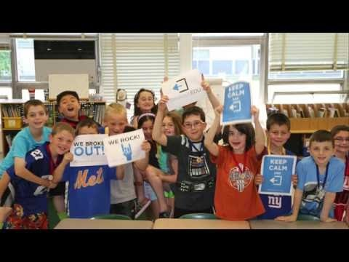
What is Breakout EDU anyway?

Slide 3
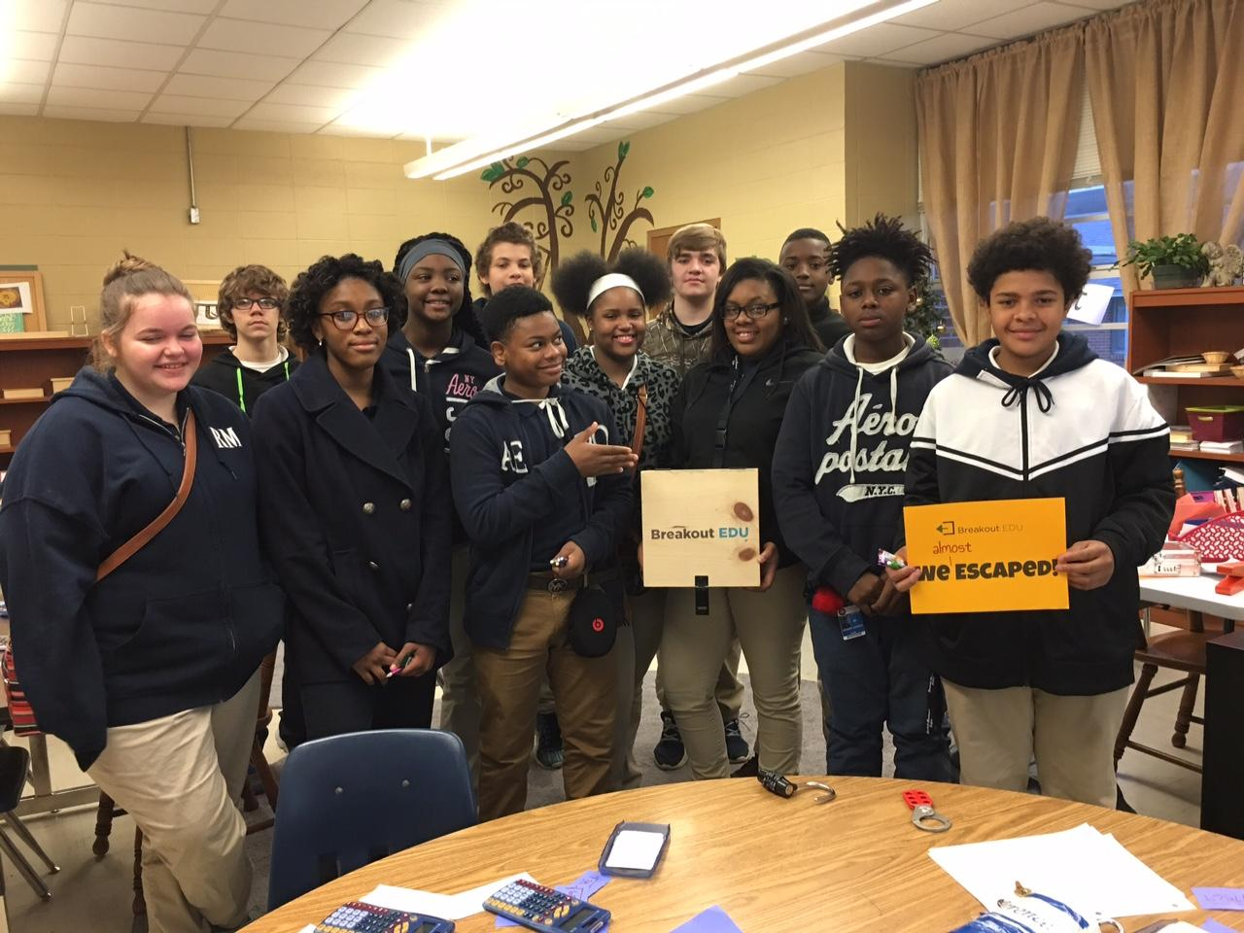
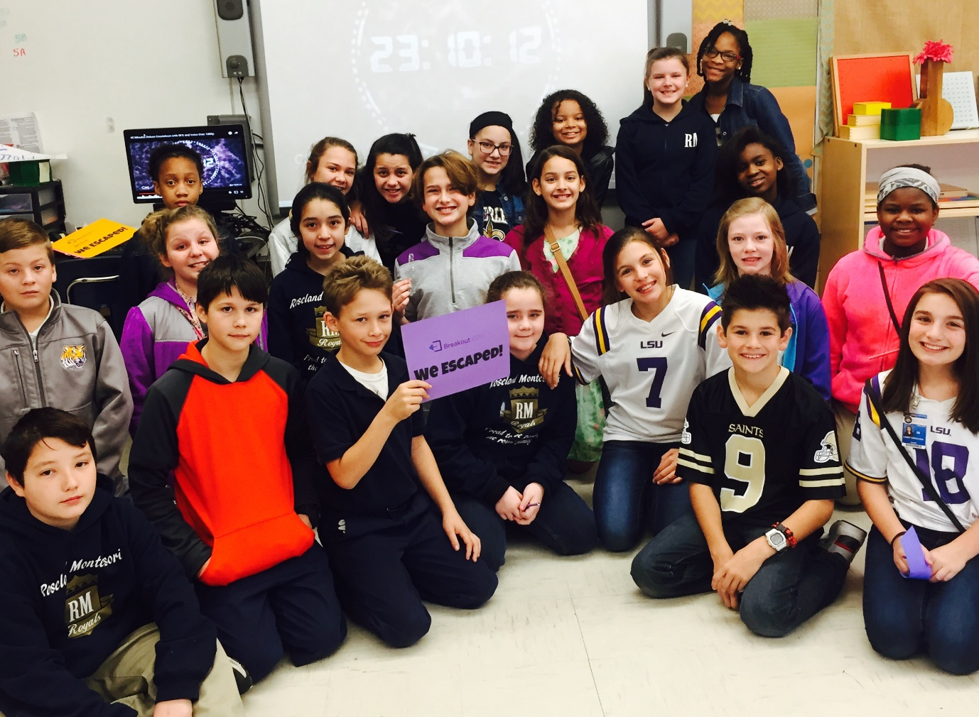
Fractions!
Slope Intercept!

Slide 4
Backstories and
Content Trailers
https://www.wbrschools.net/Page/165
McGraw Hill Education Reading Skills Videos

Slide 5
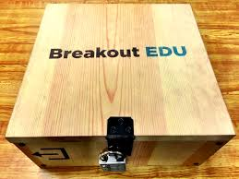
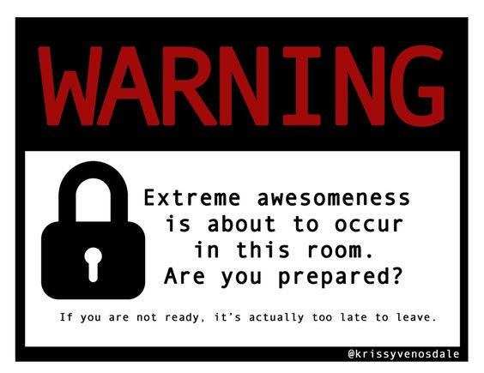
http://www.fttechtips.com/blog/breakout-edu-a-game-changer-in-engagement

Slide 6
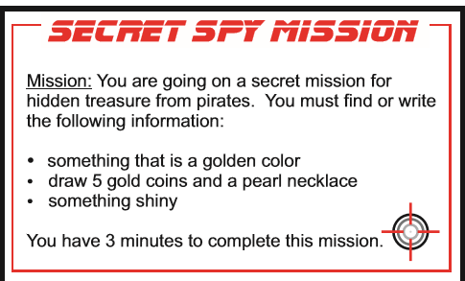
Mini-Breakouts
3 completed clue coins
Shiny object with mission code
Completed treasure map
30 minutes

Slide 8
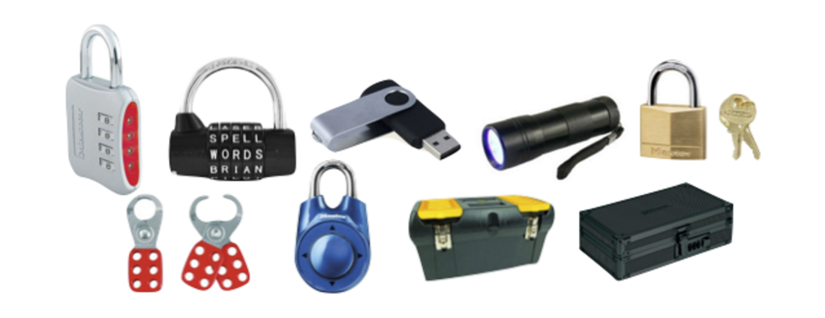
Puzzles and Locks
Unique uses for the common locks and puzzles…

Slide 9
http://blog.nowescape.com/101-best-puzzle-ideas-for-escape-rooms/

Slide 10
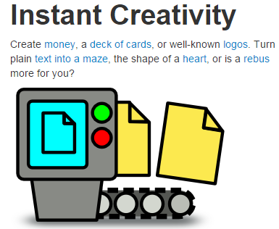
Making
Clues
https://www.festisite.com/text-layout/maze/

Slide 11
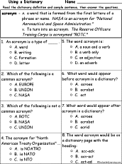
* Instead of words, use the answers to a multiple choice activity.

Slide 12
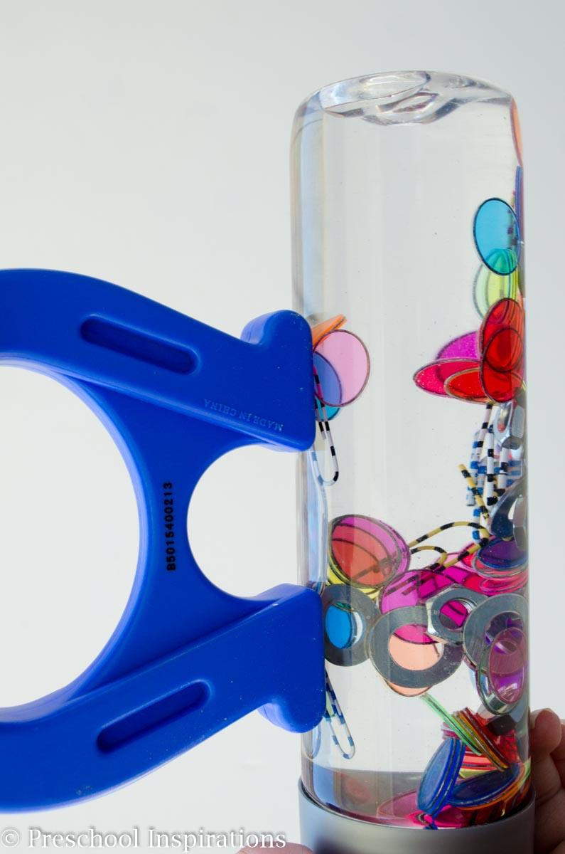
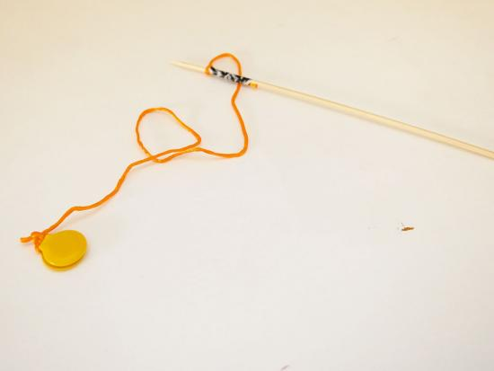
*Place objects in hard to reach areas or within other objects requiring the use of a magnet to retrieve.

Slide 13
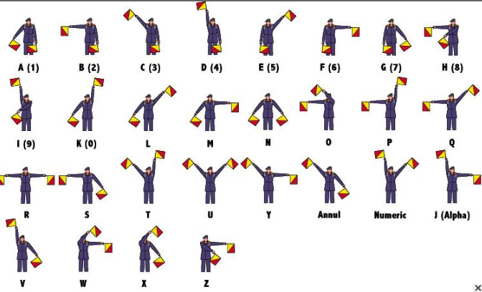
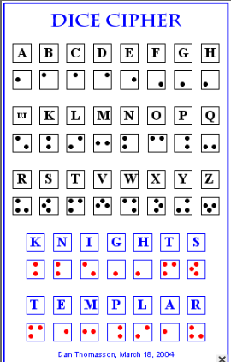
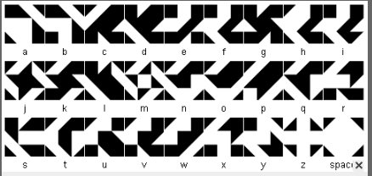
Fonts for Ciphers
http://luthorien.altervista.org/Tools/alphabets.htm

Slide 14
https://drive.google.com/drive/folders/0BxXfjC9peRoQV1lFcTVhcjhnV1U
Icons

Slide 15
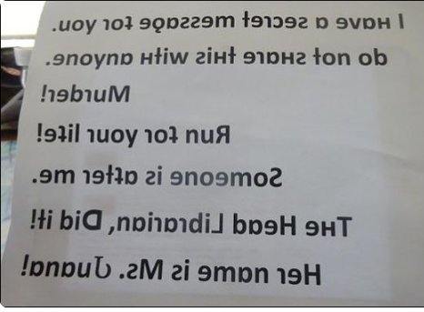
http://www.upsidedowntext.com/

Slide 16
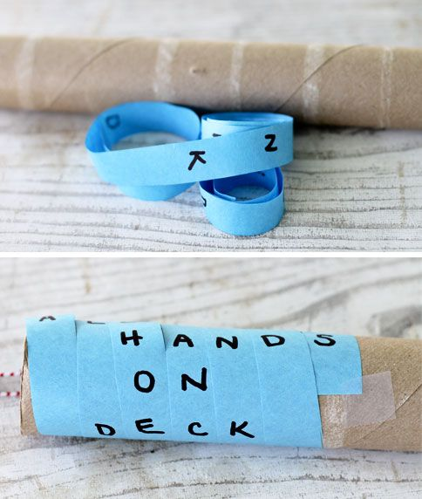
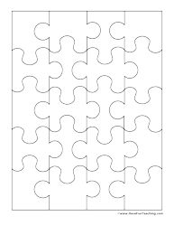
https://www.havefunteaching.com/product/activities/puzzles/blank-puzzle-20-pieces/
Make any item a puzzle by placing it over the item in Word and selecting set transparency.

Slide 17
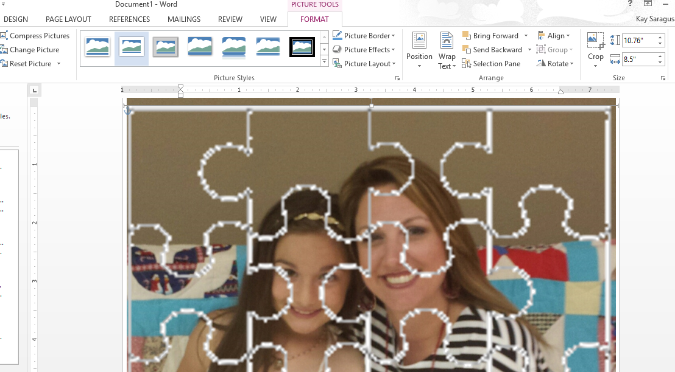

Slide 18
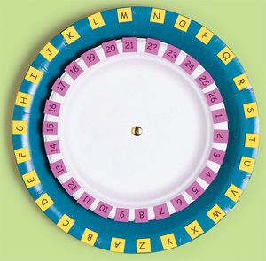
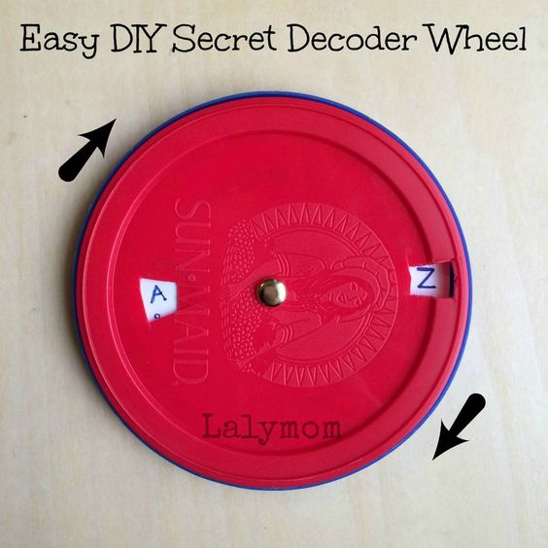
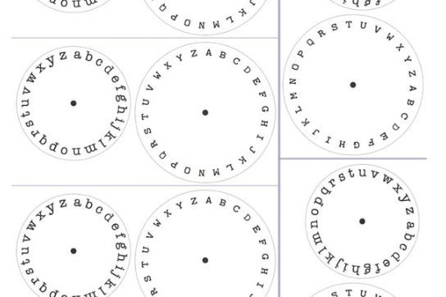
Make your own cipher wheels
https://fprint.net/wp-content/uploads/printable-cipher-wheel.pdf
To add difficulty: Make the numbers/letters match answers to problems or tasks.

Slide 19
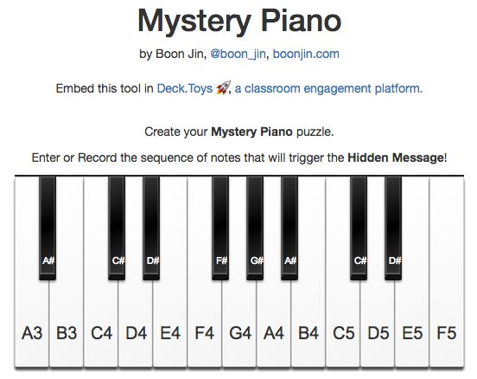
https://boonjin.com/mystery-piano/

Slide 20
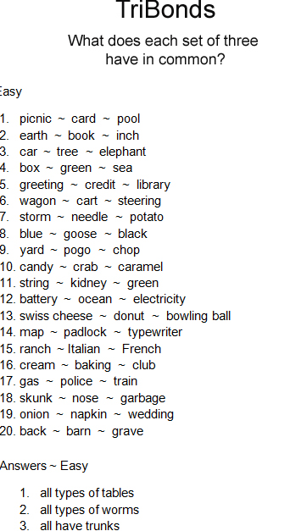
Ex. These are all tables so the clue is located at the table. These are all wheels so the clue is located on the wheel.
https://s-media-cache-ak0.pinimg.com/originals/27/77/c6/2777c6f1e6674cdad525c6f71e0c660f.jpg

Slide 21
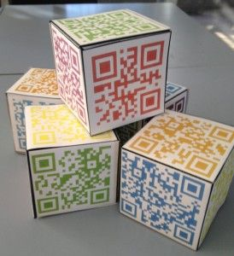
QR Codes
*Cubes
http://printables.atozteacherstuff.com/435/cube-pattern/

Slide 22
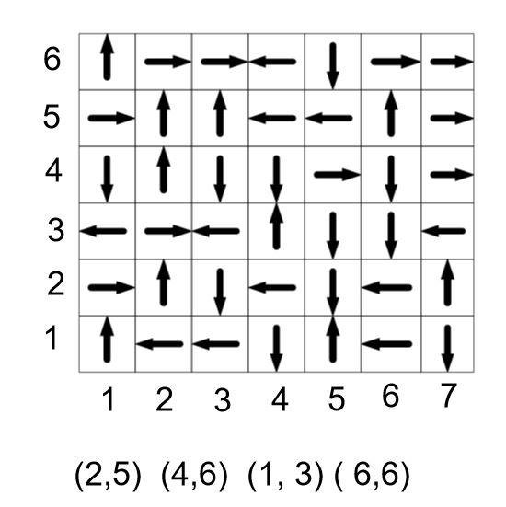

Slide 23
http://www.ransomizer.com/

Slide 24
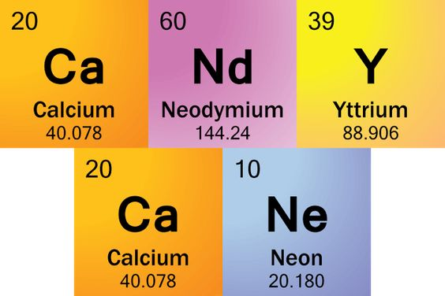
https://sites.google.com/a/esu6.org/breakoutedu/
Don’t stress your brain:
Lists of all possibilities
http://sciencenotes.org/list-words-made-periodic-table-element-symbols/

Slide 25
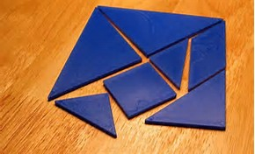
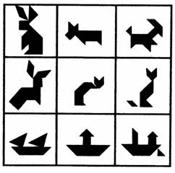
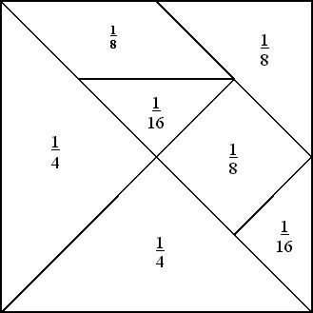
Tangrams:
Great for Spatial Thinking
Clues are on pieces left.

Slide 26
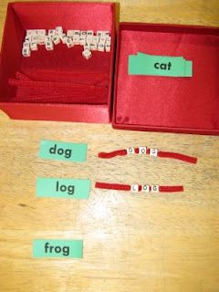
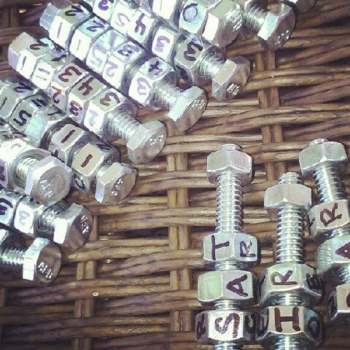
Have them spell their spelling words, answer questions from a clue worksheet, or match to a cipher and then have the remaining letters/numbers be a clue.

Slide 27
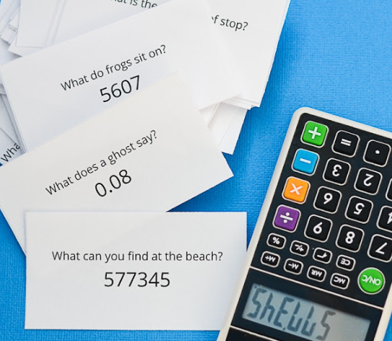
Calculator Riddles
http://www.andnextcomesl.com/2016/03/free-printable-calculator-word-riddles-for-kids.html

Slide 28
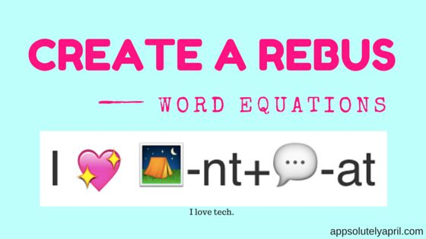
http://www.myrebus.com/

Slide 29
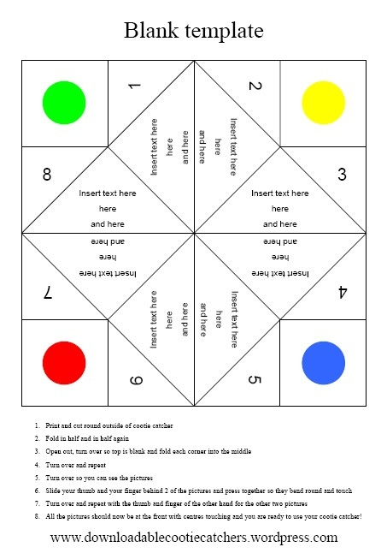
Editable Clues and Games
https://downloadablecootiecatchers.wordpress.com/

Slide 30
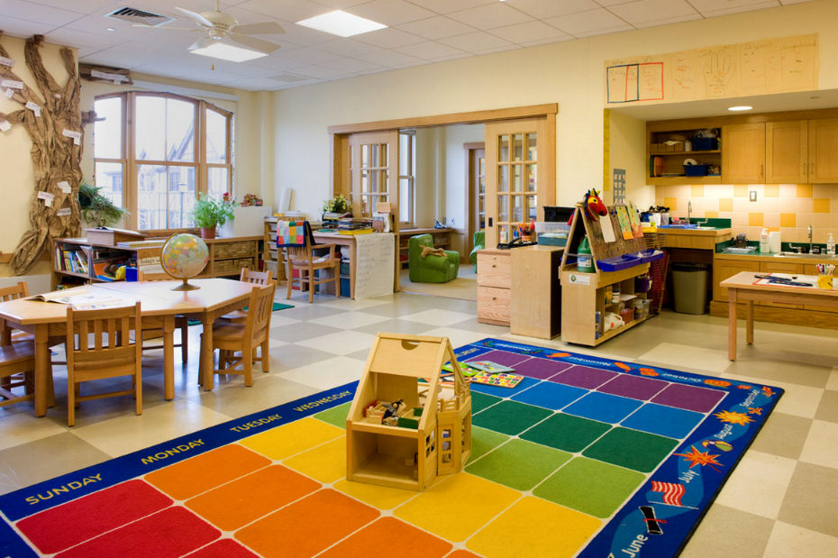
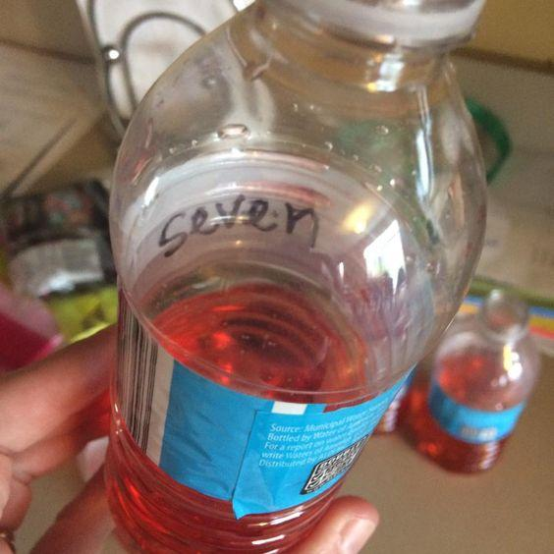
A photo of the classroom with an extra item or a missing item is a great clue!
Use what’s in the room!

Slide 31
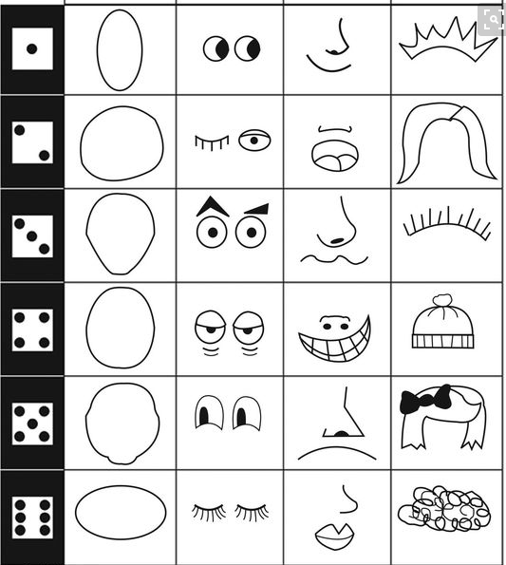
Google: Roll and Draw. Then use the Snipping tool.
Working backwards
2161

Slide 32
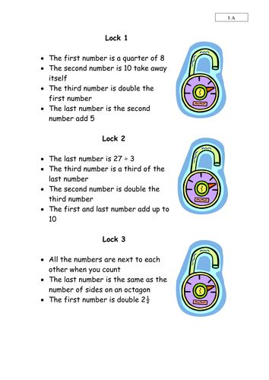
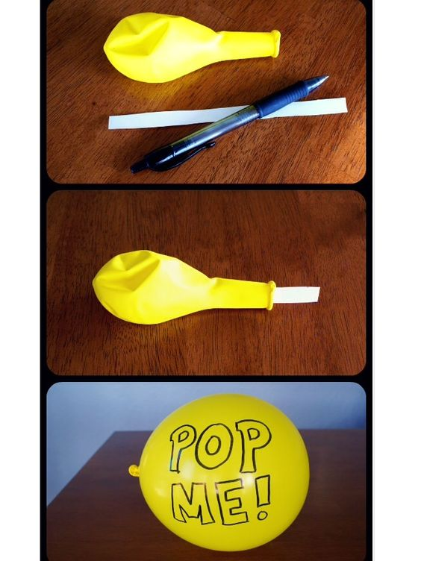
Easy Quick Clues

Slide 33
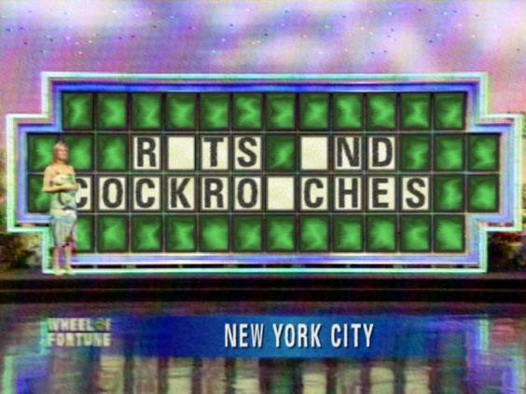
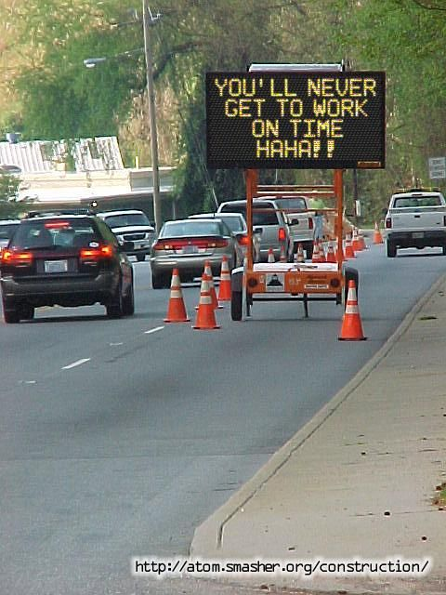
Unique Clues
http://atom.smasher.org/

Slide 34
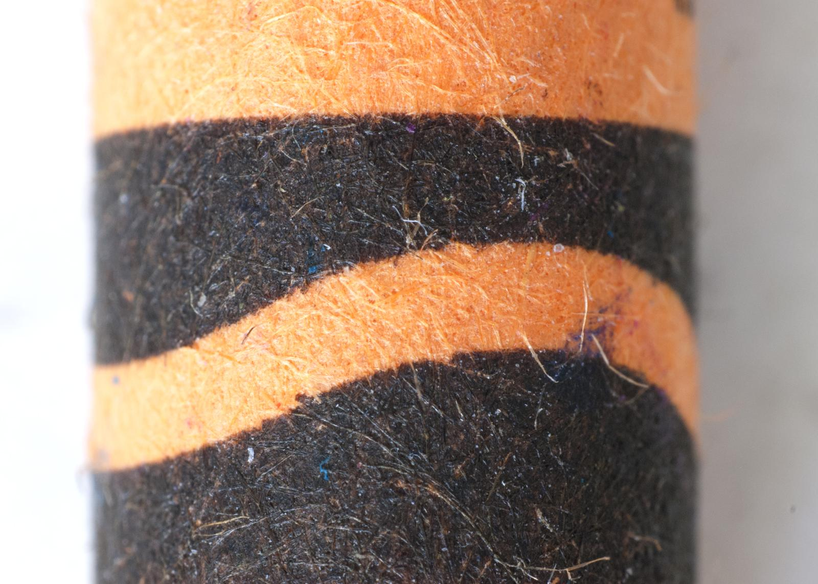
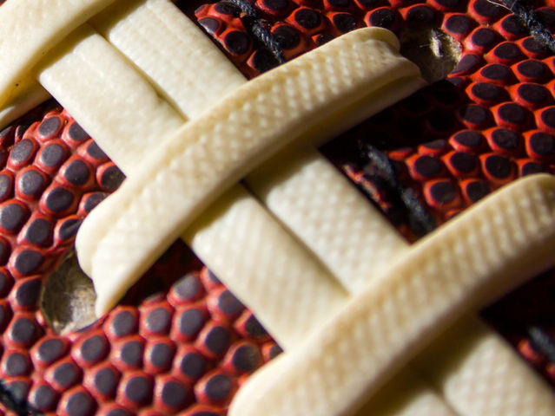
Up close clues

Slide 35
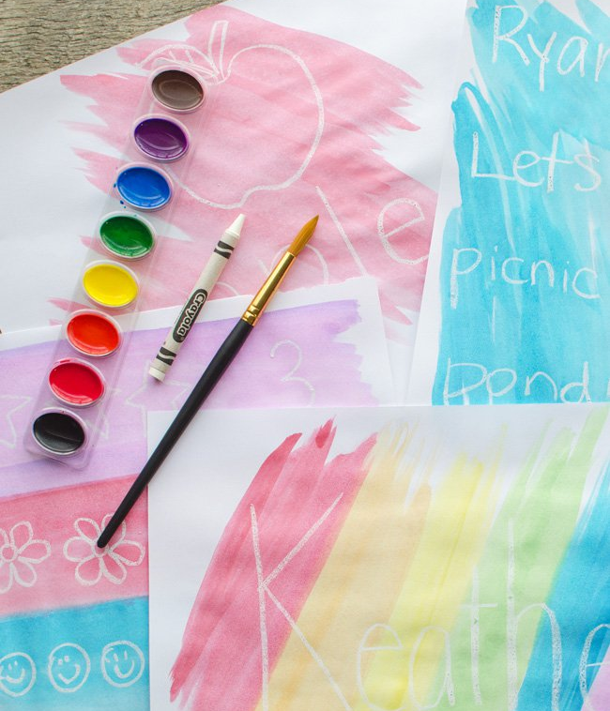
Crayon Resist

Slide 36
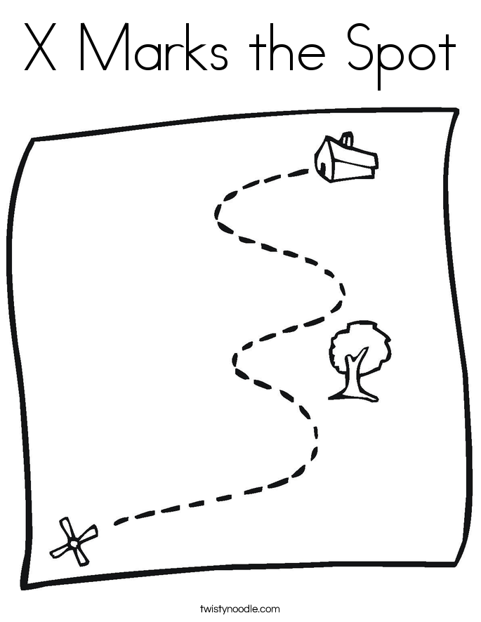
Begin on a designated spot.
Follow directions to a clue.
(measure, count, directional)

Slide 37
Set alarms to offer
clues and bonuses!
Found around the room!

Slide 38
Challenge the Play!
Play in silence
By only asking questions
Any other ideas?????

Slide 39
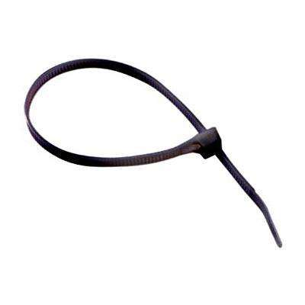
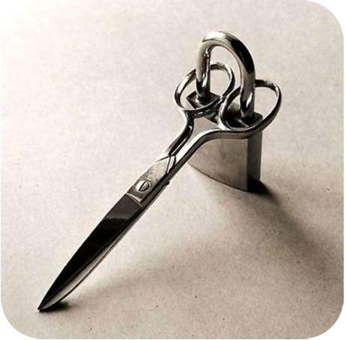
Using Locks in different ways

Slide 40
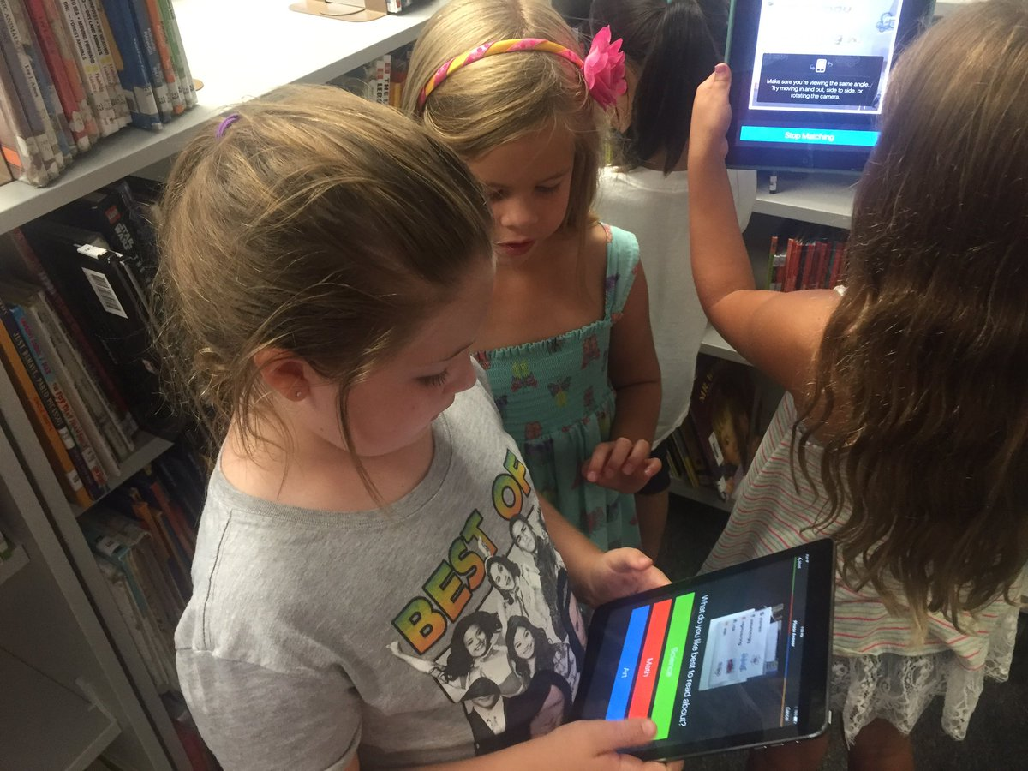
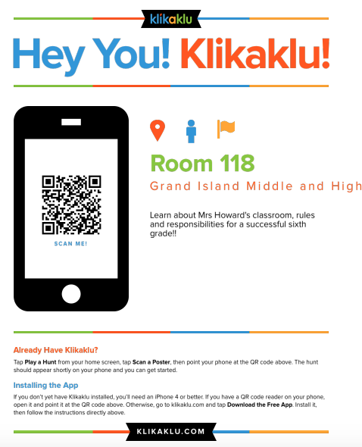

Slide 41
Ideas for assisting:
*Use penalty points for team or
penalty box for those not working
*Give random items to students
as they enter (rulers, calculators)
*Utilize a common area to gather clues,
locks, completed work

Slide 42
-How to use only 1 box
-How to reuse games
-Demo the games in your lessons or
in transition times
-Making it grade level appropriate

Slide 43
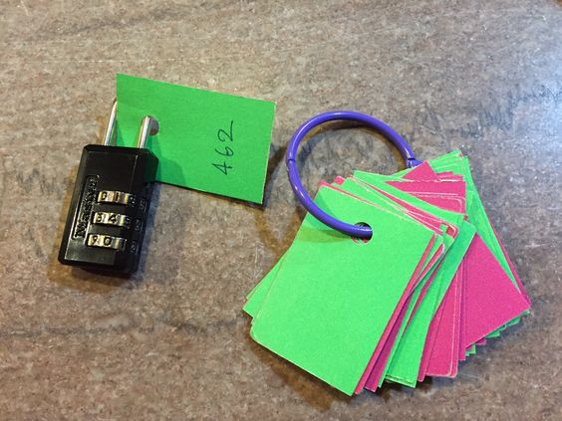

Slide 44
-Free Time
-Snacks
-the materials for a lesson
-a book
-technology
-Other ideas???

